Slide 1
File IO
(The Original Streaming Service)
Colorado State University
Computer Science Department
Slides Originally Created by Albert Lionelle (Albert.Lionelle@colostate.edu)

Slide 2
Streams Streams!
Reading Files
ifstream
Writing Files
ofstream
Special
stringstreams

Slide 3
Predefined Streams
There are four predefined streams. Only use, no need to open.
cin: standard input
cout: standard output (for normal output)
cerr: standard error (for error output)
clog: standard error (for error output)
cerr is unbuffered, clog is buffered. Use cerr for error messages, clog if you use standard error for logging purposes.

Slide 4
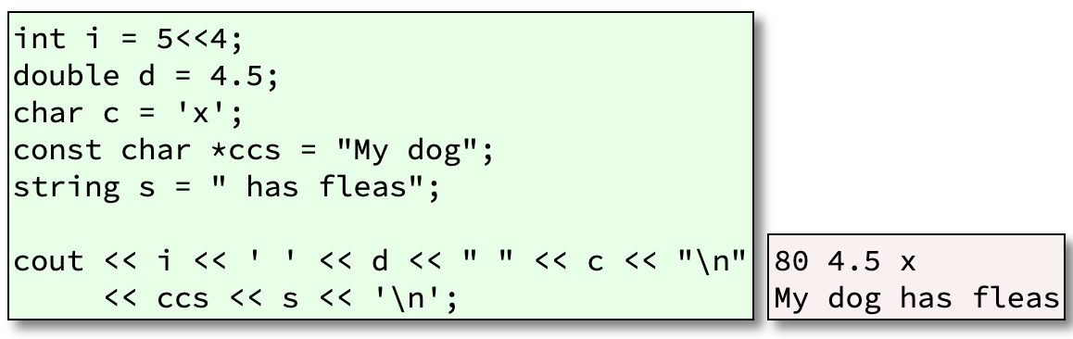
Formatted Output
The insertion operator, <<, is used for output.

Slide 5
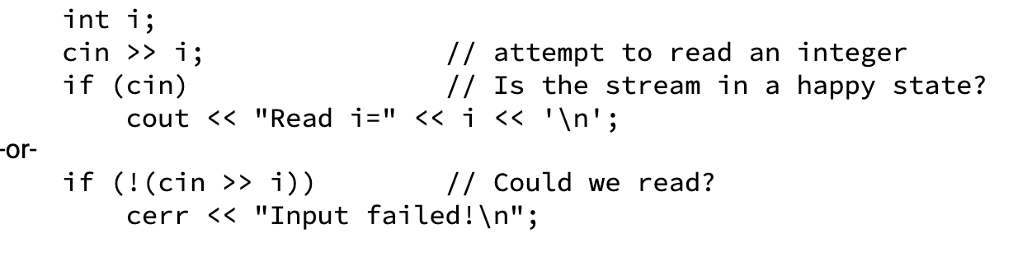
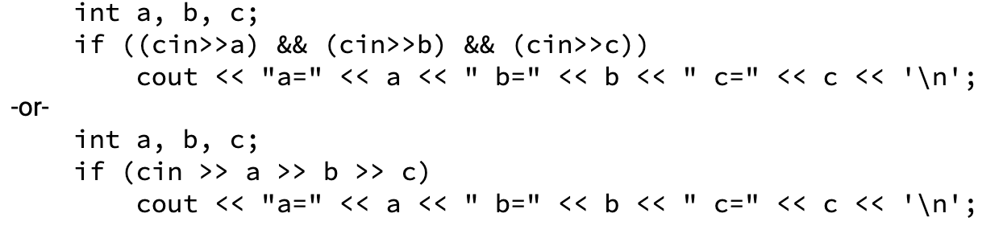
Formatted Input
The extraction operator, >>, is used for input.
Input may be chained, just like output

Slide 6
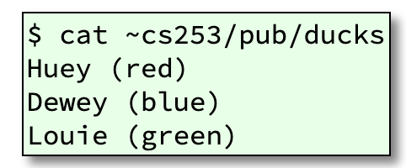

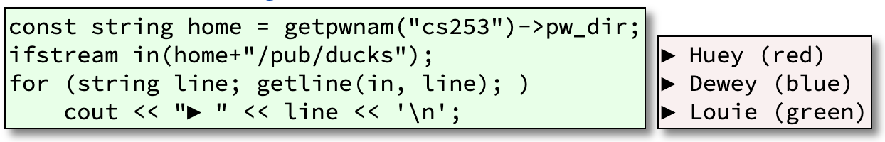
Read an Entire Line
To read an entire line, we use getline()

Slide 7
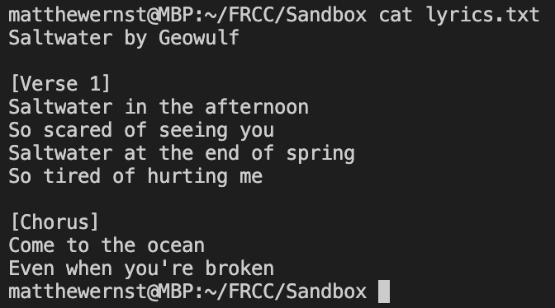
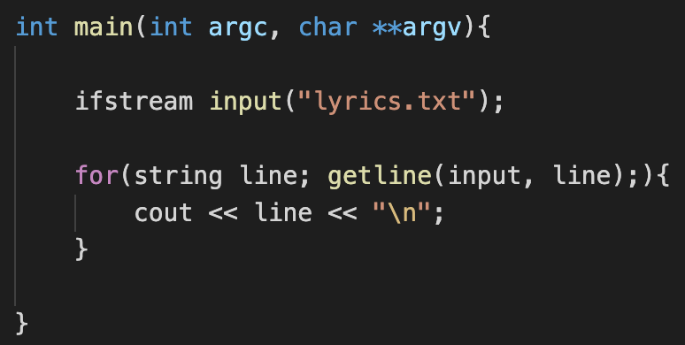
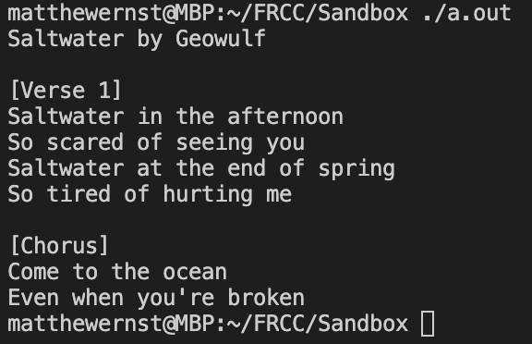
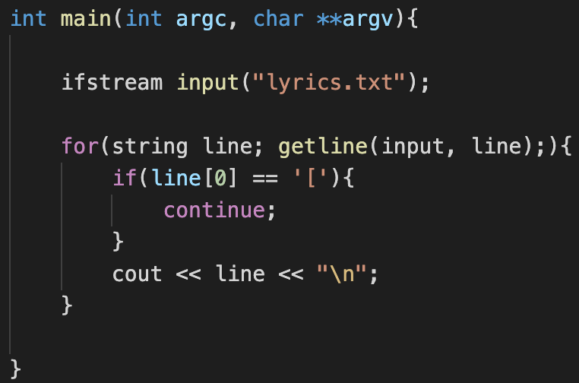
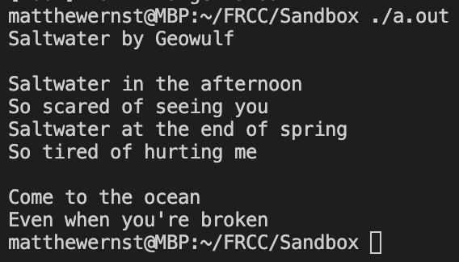
ifstream – Reading a File

Slide 8
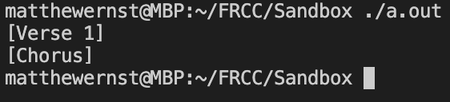
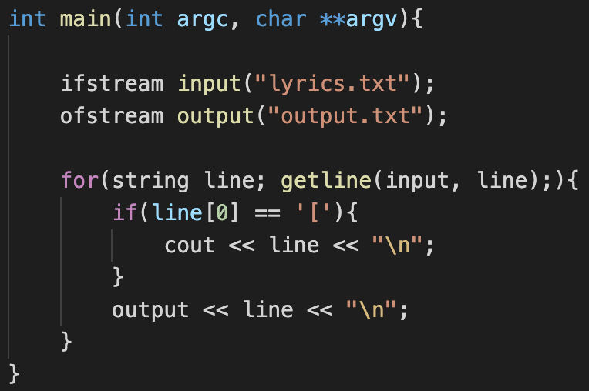
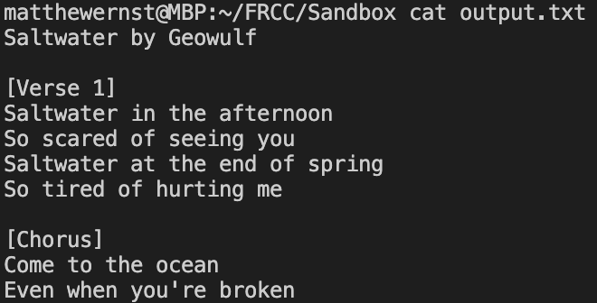
ofstream – Writing a File

Slide 9
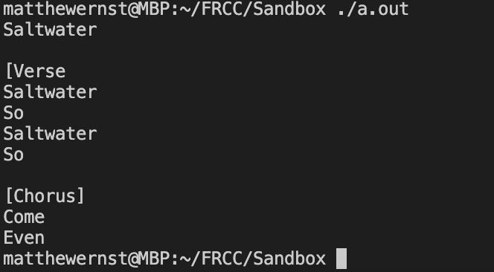
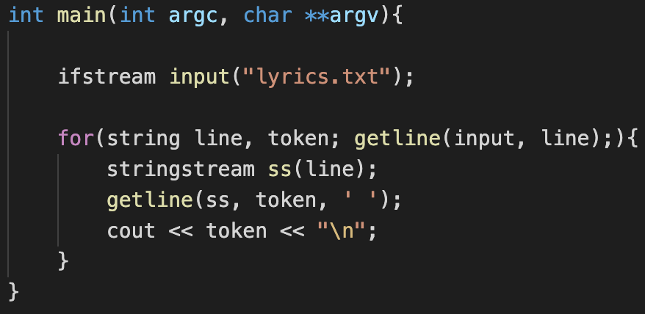
stringstream – Special Stream

